Slide 1
Adaptive behavior, scheduling, collectives, more tips and tricks

Slide 2
How can we model adaptive behaviors?
Assume that agents are objective driven.
How can they reach their objective? Are there tradeoffs?
Objective functions: set of steps designed to optimize reaching objective.
Maximizing fitness/utility
Do behaviors change while working towards objective?

Slide 3
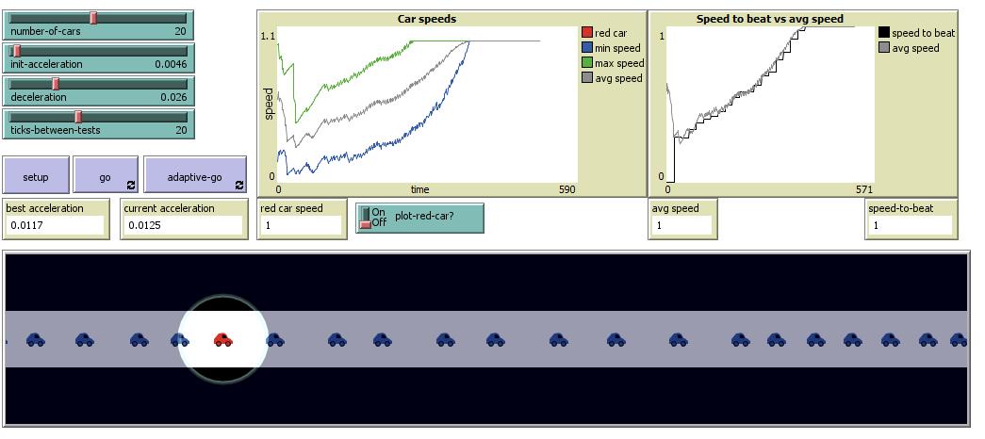
Objective functions
Identify alternatives
Eliminate infeasible
Evaluate feasible by how well they meet objective function
Select best alternatives
Objective: maintain smooth flow of traffic
Behaviors: accelerate if no cars ahead; decelerate if car is close ahead

Slide 4
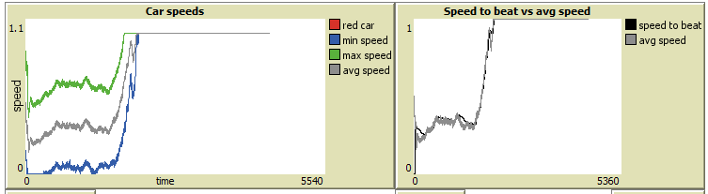
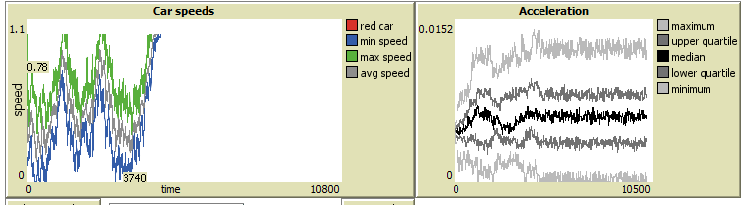
All cars adapt in unison (equilibrium: 1850)
All cars adapt individually
(equilibrium: 4690)

Slide 5
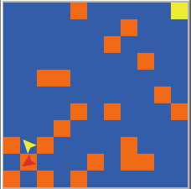
Filtering and subsetting
Create agentsets to filter out unwanted patches/turtles
Evaluate filtered set
Example: Create subset of blue patches with orange neighbors
Any? primitive that identifies an agentset that meets a condition
Objective: get to the yellow patch.
Behavior: move faster in orange patches and slower in blue
set new-patchset patches with [(pcolor = blue) and (any? (neighbors with [pcolor = orange]))]

Slide 6
Subsetting coding: what’s the difference?
Let destination (patches in-radius 3)
Let destination (patches in-radius 3) of patch-here
Let destination other patches in-radius 3
Let destination (other patches in-radius 3) of patch-here
Notes:
In-radius measures distance from agent calling it. In 1) it’s a turtle calling it and the turtle might not be in the center of the patch. (2) in radius is called by the turtle’s patch, which is always the center point

Slide 7
Subsetting coding
Let nearest-neighbors turtles with-min [distance myself]
Let nearest-neighbors other turtles with-min [distance myself]
Notes:
With-min: reports an agentset of turtles that have minimum value of the reporter
Distance: distance from this agent to given turtle or patch
Myself: agent who asked me to do what I’m doing
Self: me
1) returns agents set with

Slide 9
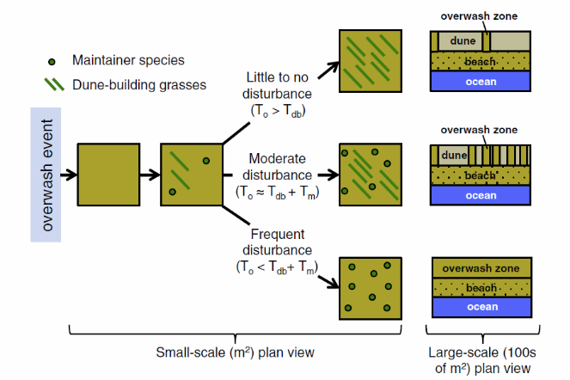
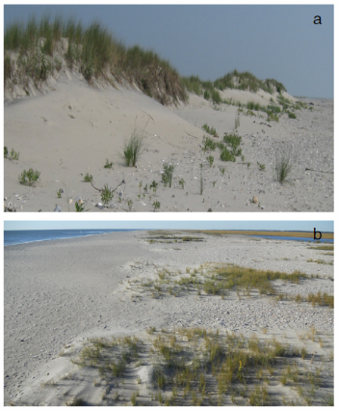
Role of vegetation in dune storm response & recovery
from Wolner et al., 2013
Notes:
Vegetation and storm response
Root reinforcement of dunes
Mycorrizhal fungi
Wave attenuation, reduced erosion
Surface armoring
Vegetation and dune recovery
Trapping wind-blown sand particles

Slide 10
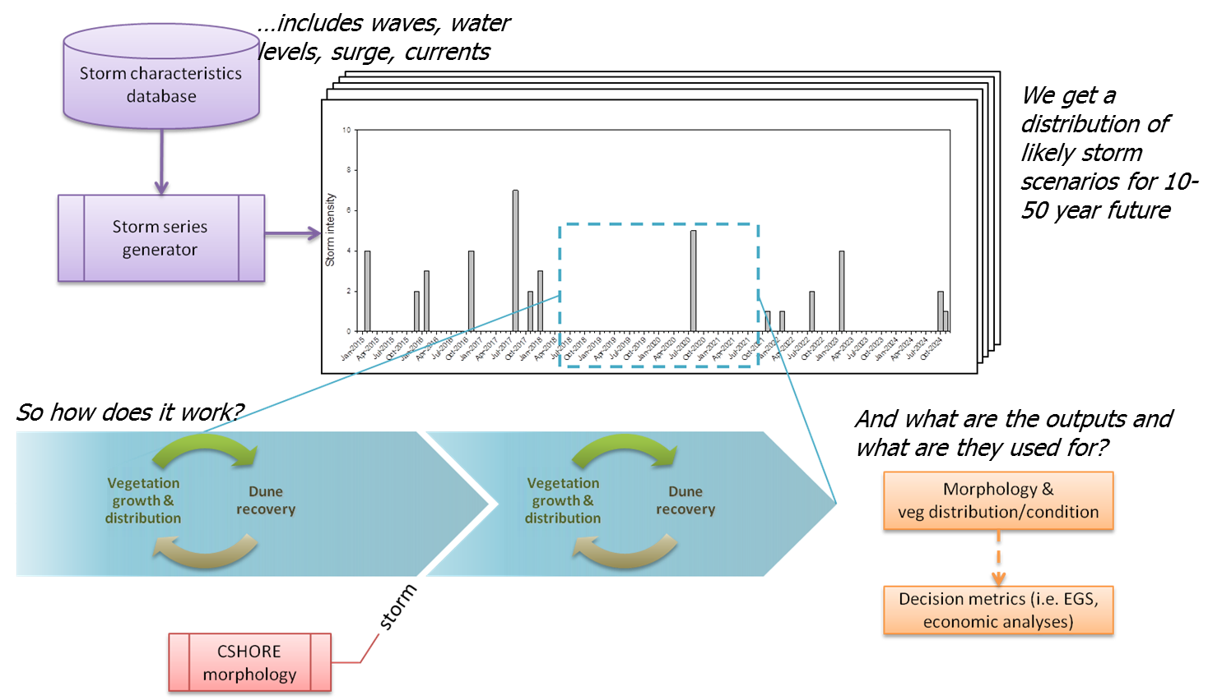
Integrating morphology and ecological modeling to better predict response and recovery

Slide 11
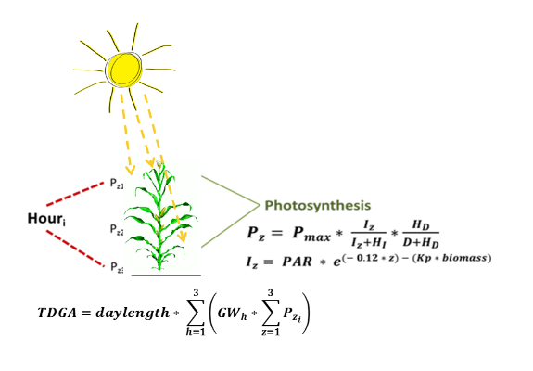
Mechanistic models of plant growth
Modeled growth at individual plant level via mechanistic photosynthesis growth model.
Three community model
Foundation is built on crop models
Can incorporate response to
disturbance at multiple scales
Notes:
Different scales: including light, season, soil content, plant part, species, environment

Slide 12
CSHORE-veg: vegetation dynamics
Solar radiation
Survive?
Mortality
Biomass
Temp
Growth
Veg
CSHORE
Elevation
Dispersal
Topo-bathy (from CSHORE-dune modules)
Survive?
Dune module
Erosion & burial
Colonization
Water levels (from CSHORE)
Distance from shore

Slide 13
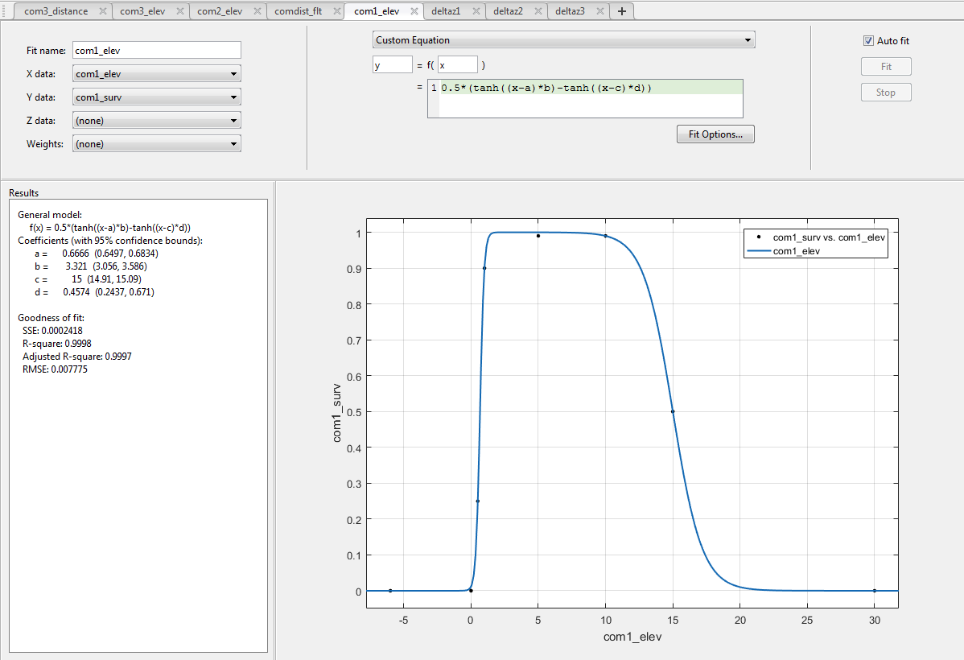
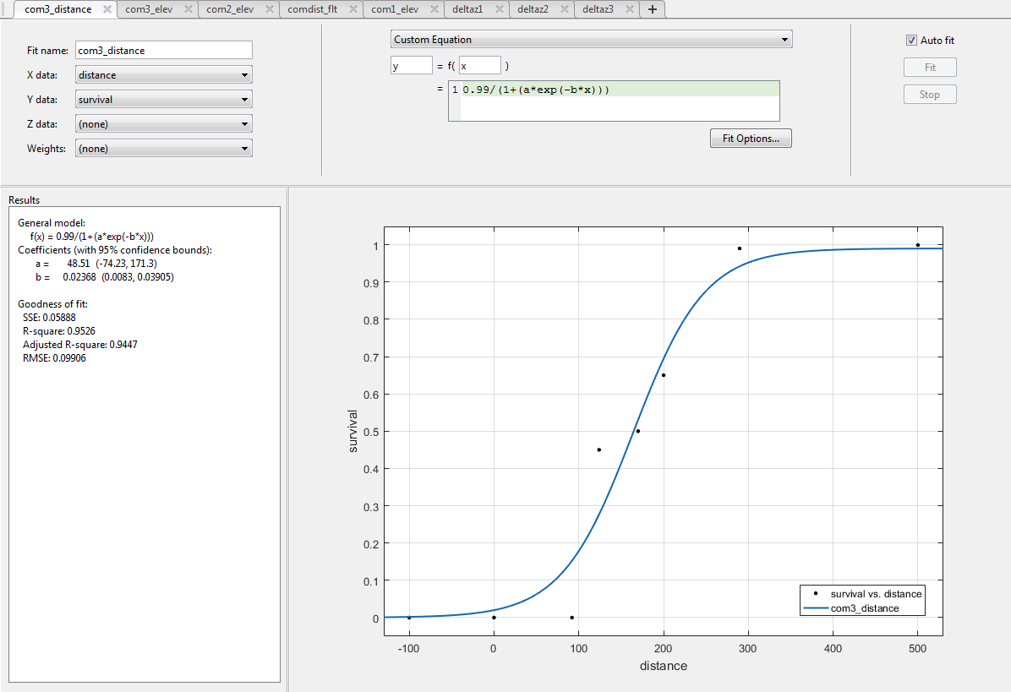
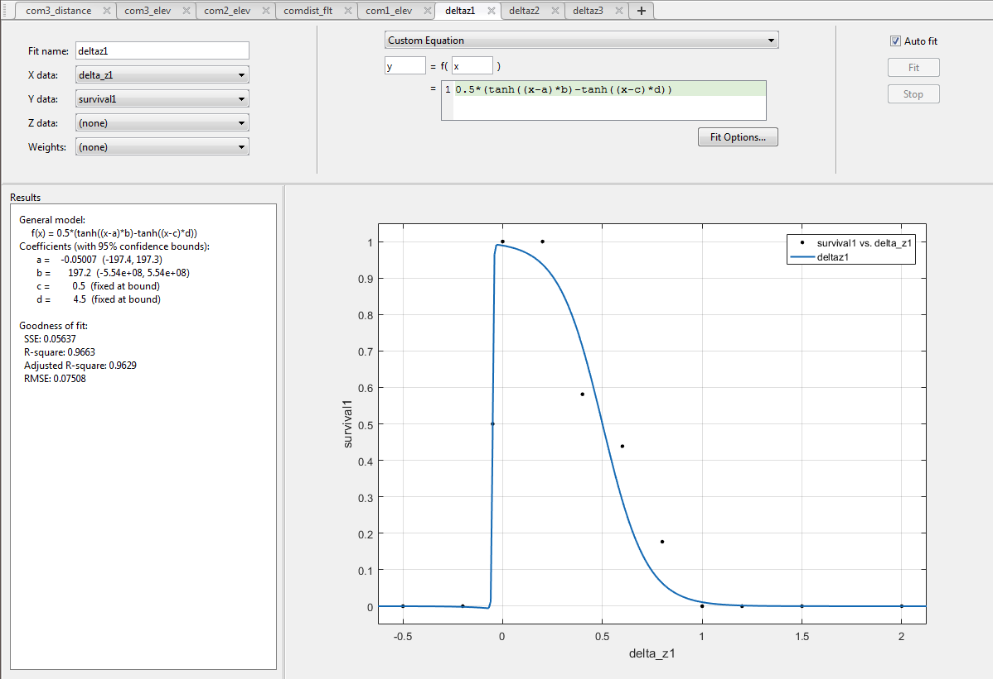
Community-specific survival
3 communities (growth habit and function)
Burial tolerant dune-builders (i.e. Ammophila spp.)
Burial tolerant dune stabilizers (swale species, bryophytes, various sparse perennials)
Burial intolerant dune stabilizers (i.e. Myrica spp.)
3 mortality mechanisms
Elevation (surrogate for flood tolerance
Distance from shore (surrogate for salt spray tolerance)
Burial/erosion
Elevation – hyperbolic tangent
Distance – generalized logistic
∆z (±) – hyperbolic tangent

Slide 14
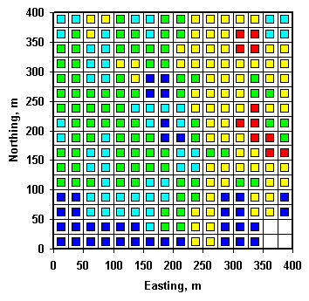
Modeling spatial dynamics of vegetation
Plant dispersal is poorly understood, but necessary to incorporate in predictive models
Developed an approach to capture spatial dynamics of plants matrix-based nearest-neighbor, dependent on size and age of plant

Slide 15
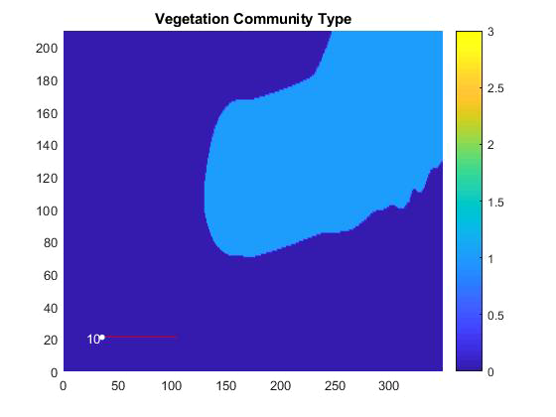
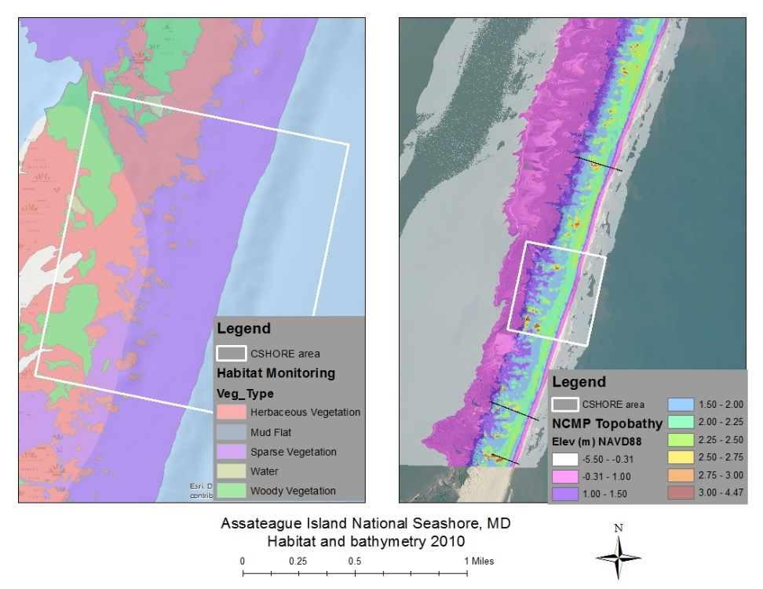
CSHORE-veg: vegetation evolution validation
Testing:
Randomly seed vegetation over known domain
Check if evolution results in observed condition
Initial results: Model diffuses towards dominance of dune vegetation

Slide 16
Integrating the elements…
20-yr hindcast run of shore position without dune recovery
Vegetation can shape the response of the beach-dune system and alter the vulnerability to future storm events
We can alter storm frequency/intensity and SLR rate to determine how vegetation patterns may change
Future work – improve probabilistic predictive capabilities

Slide 17
THANKS!
Any questions?
You can find me at:
Todd.m.Swannack@usace.army.mil

